Slide 1
i2b2 – caGrid Data Services
Beta Demo
Aug 19, 2009
David W. Ervin

Slide 2
i2b2 – caGrid Data Services
i2b2 (Informatics for Integrating Biology and the Bedside) provides a mechanism for storing clinical research data
Utilizes a Star Schema style database
Allows storage of arbitrary data types, but makes retrieval of typed information complicated
OntoMapper tool bridges this data to the semantically annotated and object oriented world of caBIG
Assigns CDEs from caDSR to data elements identified by a query path
i2b2 Data Services will provide query capabilities into an i2b2 database utilizing mappings produced by OntoMapper and a specially annotated caGrid Domain Model
Exposes all or a subset of the data types stored in an i2b2 instance
Leverages existing caGrid data service interface and query language
Ensures transparent interoperability with existing tooling (FQP, standard data service clients, etc).

Slide 3
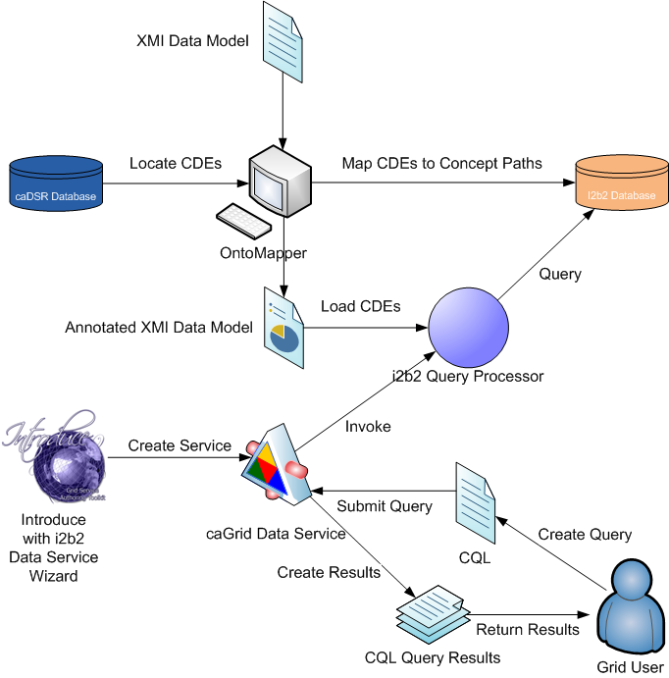
I2b2 – caGrid Data Services

Slide 4
i2b2 – caGrid Data Services
OntoMapper used to annotate data model and i2b2 database with CDEs
CDEs derived from caDSR or OpenMDR
Introduce toolkit with i2b2 Data Service creation wizard generates a caGrid Data Service
Developer specifies annotated XMI data model
Data Service invokes i2b2 CQL Query Processor in response to CQL queries
Query Processor locates CDEs for each class / attribute in the annotated XMI data model
CDEs used to discover i2b2 query paths
Data is extracted from the i2b2 database and processed into CQL query results for the grid user

Slide 5
Introduce
A framework which enables fast and easy creation of Globus and Standards based grid services
Provide easy to use graphical service authoring tool
Hide all “grid-ness” from the developer
Toolkit for creating and manipulating strongly typed grid services
Command line and GUI tools for service skeleton generation and automatic service/client code generation
Utilizes other core grid services and architecture components
caDSR and GME for schemas of registered data types
Security service architecture (Dorian, GridGrouper, CSM)
Advertisement and Registration configuration and
Index Service for discovery

Slide 6
caGrid Data Services
caGrid Data Services expose data resources to the Grid
Specialization of standard caGrid grid services to expose data through a common query interface
Meet all base service requirements of caGrid services
Present an object view of data sources
Exposed objects are registered in caDSR (cancer Data Standards Repository) and their XML representation in GME
Data Service Metadata describes objects and relationships in a unified domain model
Queries made with CQL Query objects
Results returned as objects nested in a CQL Query Result Set
Created and managed with an extension to the Introduce Toolkit

Slide 7
Simplified service development process
Data Service Extension to Introduce
Automatically copies Jars, Schemas, and WSDLs
Adds standard query method to service
Can optionally add methods for WS-Enumeration and Transfer
Adds supporting service extensions as needed
Extendable via data service styles (of which i2b2 is one!)
Multiple extension points
Creation of service
Editing in Introduce with style-specific UI tab
Modification (save and synchronize)
Allows specialization of the data service extension
Includes service creation wizard functionality
Complicated and custom tooling can be made organized and easily repeatable

Slide 8
caGrid Query Language (CQL)
Simple, “minimum entry” for data providers
Specifies a target object (result) type and selects the instances which satisfy the specified properties and nested object properties
Allows object - association path navigation
Provides logical grouping (AND / OR)
Provides name/predicate/value filtering on attributes of objects
Recursively defined
Arbitrary association path length with repeating XML elements
Ability to return full Objects, Set of attributes, count of results, or distinct attribute values

Slide 9
caGrid Query Language (CQL)
Defined by XML schema
Published in GME
Included in every caGrid Data Service
Queries constructed in one of two ways
CQL object API
Java beans derived from CQL schema
Simple getter / setter functionality to add query components
Written XML document
Deserialized into CQL object and used with data service client API
Passed by other means over SOAP interface (soapUI tool, perl, python, .NET, etc).
Notes:
Passed by other means… soapui tool, perl, .NET… anything that can talk to the data service; it doesn’t have to be the Java client.

Slide 10
Live Demo
Prerequisites:
caGrid Installed, Tomcat installed, Globus deployed, i2b2 data service style installed to Introduce
Start Introduce Toolkit
Create a new service
Name, package, directory
Choose “Data Service” option
Select the i2b2 Ontomapper data service style
Follow through the wizard, filling in required values
Database connection information, domain model, XML schema

Slide 11
Live Demo
Introduce creates the core service skeleton
Data Services extension add standard query method
i2b2 Style adds CQL query processor and configures it with the information provided in the wizard
Service is ready to be used

Slide 12
Live Demo
Deploy the i2b2 data service to Tomcat
Standard web service container for caGrid services
Import the service into Eclipse
Add Query Runner class
Execute CQL queries against the data service

Slide 13
Wrap Up
i2b2 Database with ontomapper edits
Standard caGrid tools
Introduce Toolkit and Data Services extension
i2b2 Data Service style
Query processor, database access tools
caGrid queries in CQL executed against an i2b2 resource and object results are returned

Slide 15
Backup Slides

Slide 16
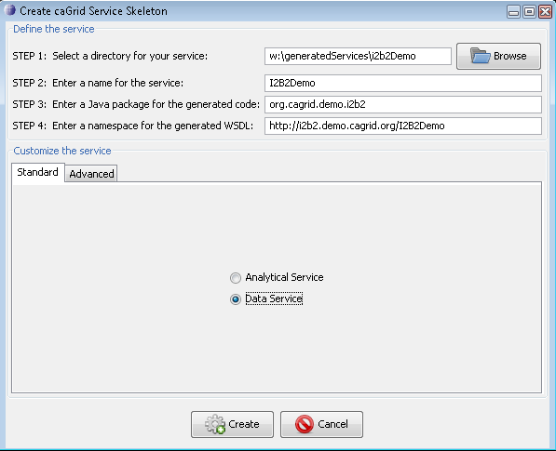
Creating Data Service

Slide 17
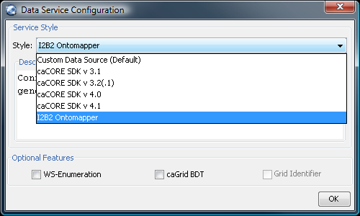
Data Service Style

Slide 18
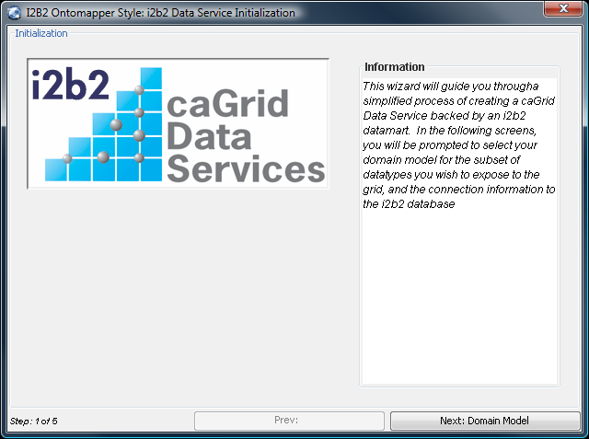
Wizard

Slide 19
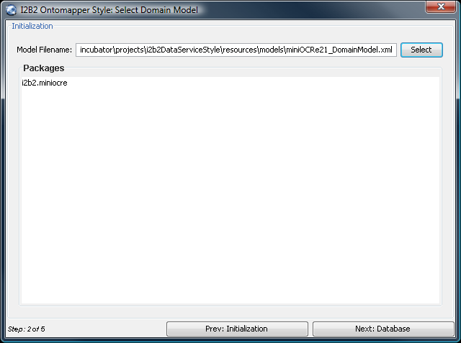
Wizard

Slide 20
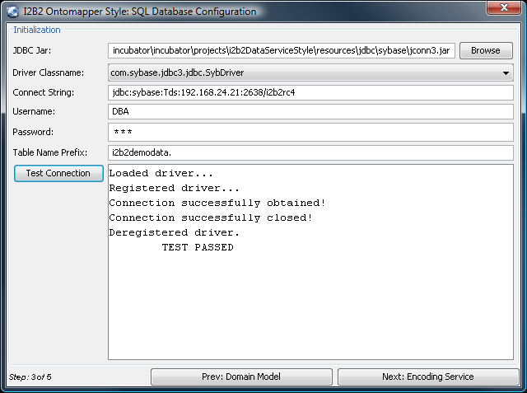
Wizard

Slide 21
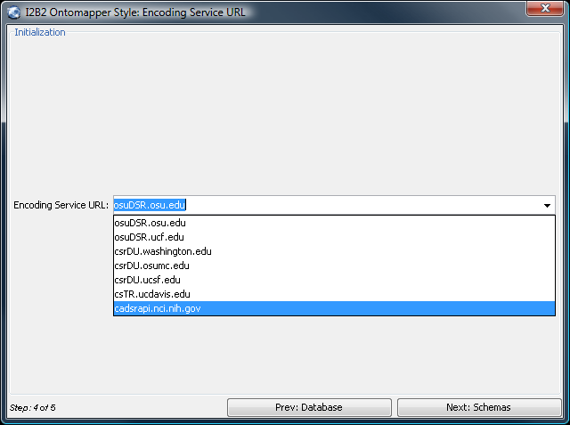
Wizard

Slide 22
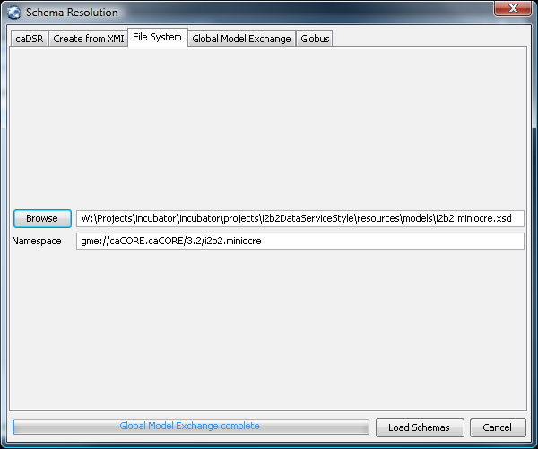
Wizard

Slide 23
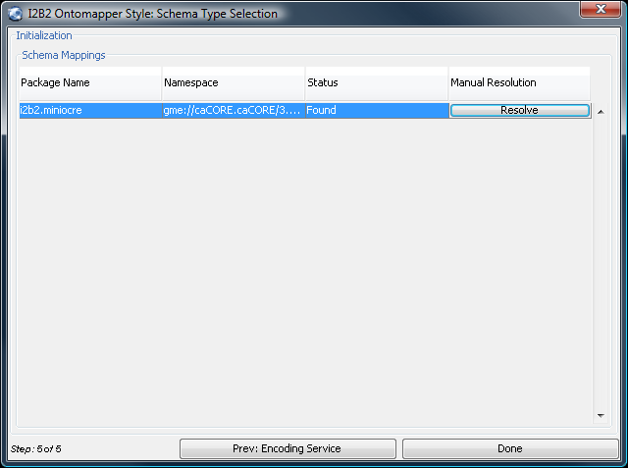
Wizard

Slide 24
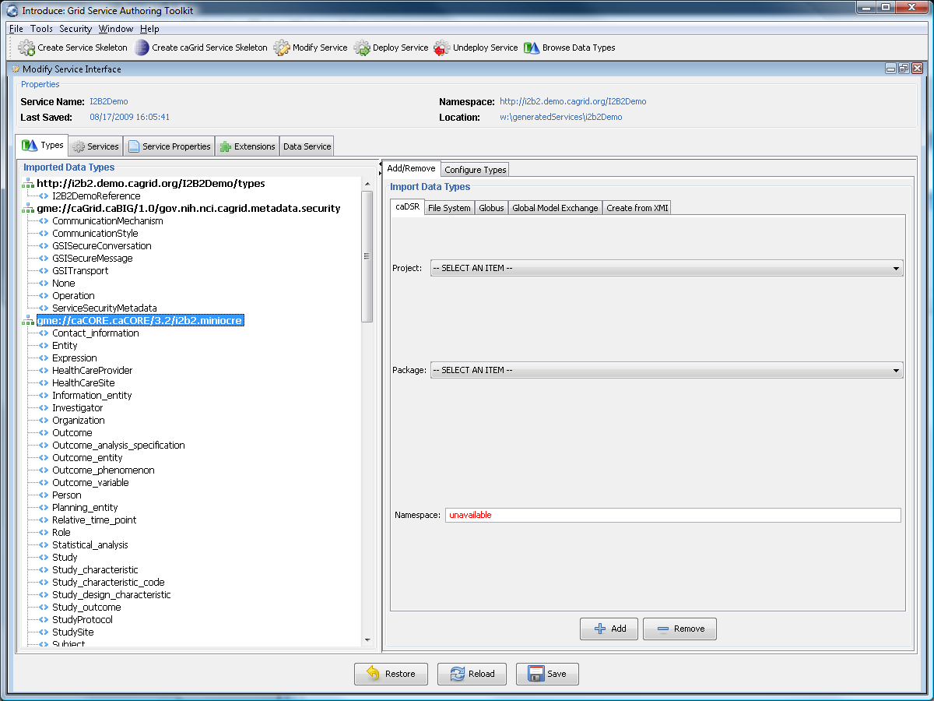
Types

Slide 25
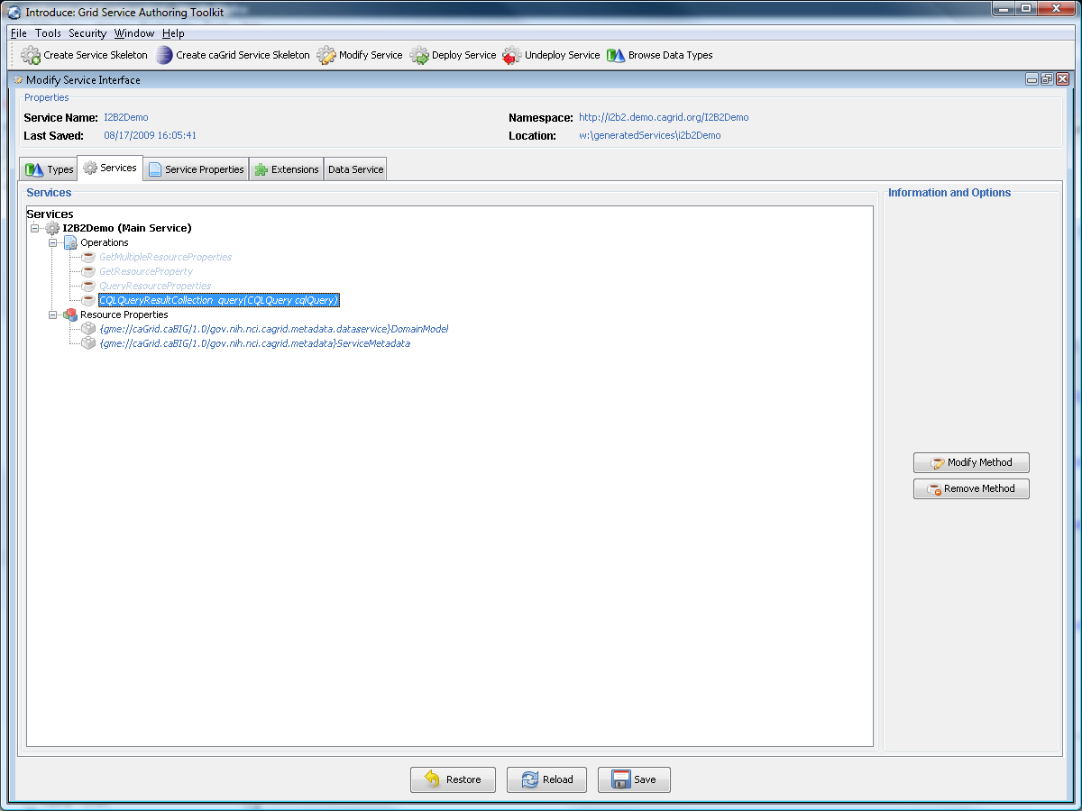
Operations

Slide 26
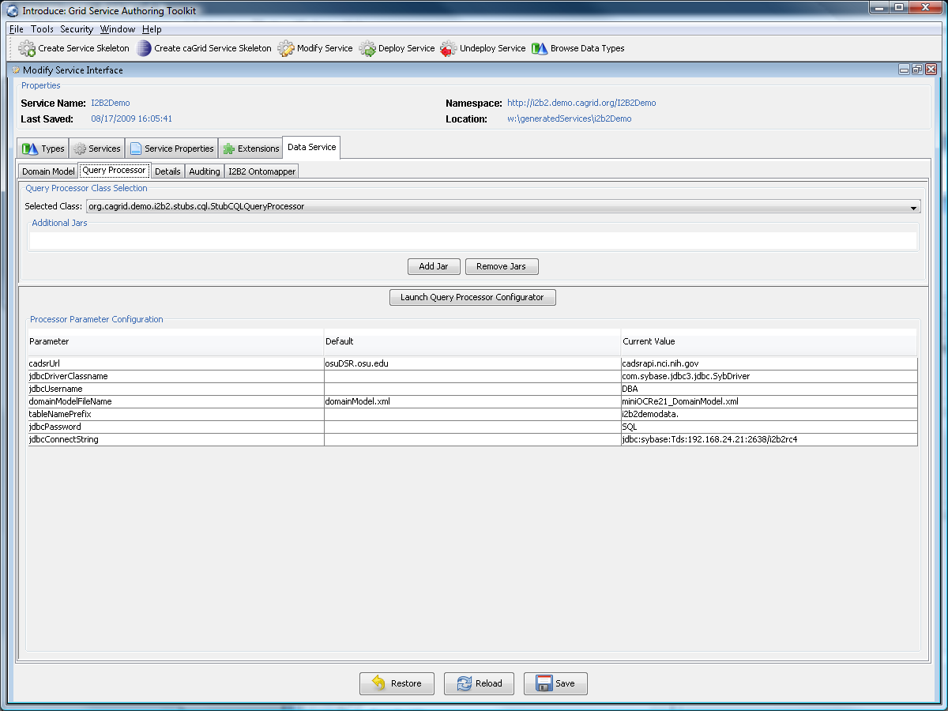
Query Processor

Slide 27
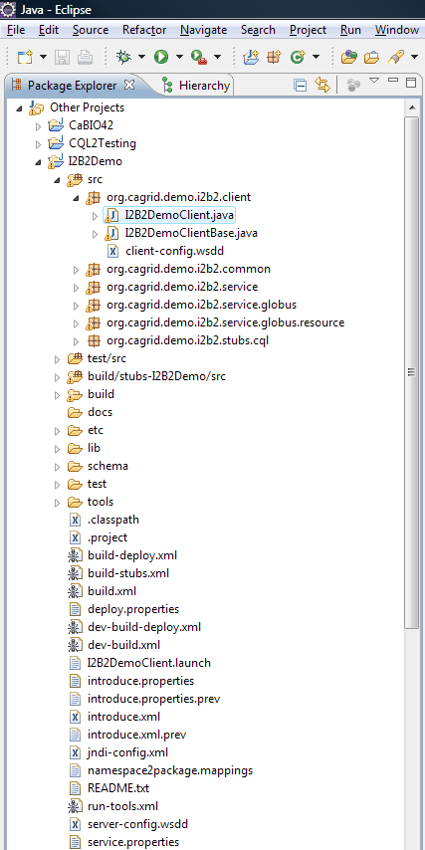
Eclipse

Slide 28
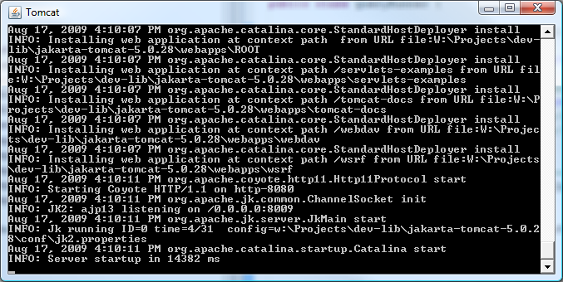
Tomcat

Slide 29
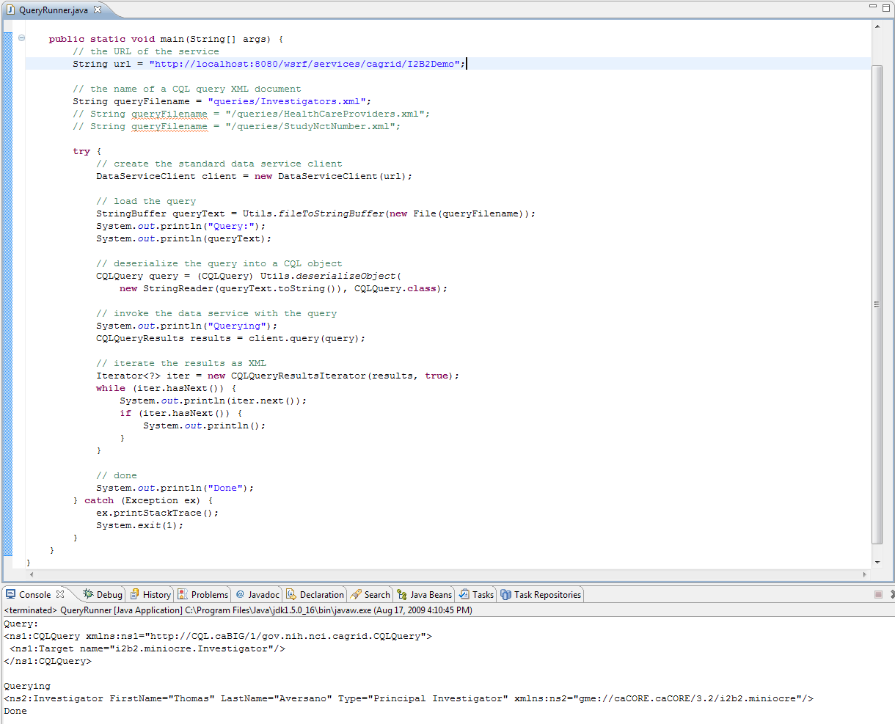
Query Runner

